Slide 1
Simultaneous Localization and Mapping: Part 1
Chitradevi Maruthavanan Fall 2023

Slide 2
SLAM Introduction
Simultaneous Localization and Mapping problem - ‘Is it possible for a mobile robot placed at an unknown location in an unknown environment to build a consistent map of the environment and to simultaneously determine its location within the map.’
Part 1 tutorial/survey - Definition of SLAM problem in standard bayesian form - Solution for SLAM problem through 2 methods: Extended Kalman Filter (EKF-SLAM) and Rao-Blackwellized particle filters (FastSLAM)

Slide 3
History
During 1900s the paper by Smith showed that mobile robot moves through an unknown environment and takes relative observations of landmarks. The estimates of these landmarks are all correlated with each other because of the common error in estimated vehicle locations.
A consistent full solution to the combined localization and mapping problem would require a joint state composed of the vehicle pose and every landmark position, to be updated following each observation.
This would require the estimator to use a huge state vector based on the size of the number of landmarks in the map.
But, It was assumed that the estimated mapping errors would not converge. It would be a random-walk behavior with unbounded error growth.
Hence, the theoretical work on combined localization and mapping was temporarily halted.

Slide 4
Breakthrough
The conceptual solution for the combined mapping and localization problem, once defined as a single estimation problem, was actually convergent.
The structure of the SLAM problem, the convergence result and the providing of the acronym SLAM was first presented in a mobile robotics survey paper presented at the 1995 International Symposium on Robotics Research [16].

Slide 5
Formulation of SLAM problem
SLAM is a process by which a mobile robot can build a map of an environment and at the same time use this map to find its location.
Consider a mobile robot moving through an environment taking relative observations of a number of unknown landmarks using a sensor located on the robot. At a time instant k, the following quantities are defined
◆ xk: the state vector defining the location and orientation of the vehicle
◆ uk: the control vector, applied at time k - 1 to move the vehicle to a state xk at time k
◆ mi: a vector defining the location of the ith landmark
◆ zik: an observation from landmark mi at time k.

Slide 6
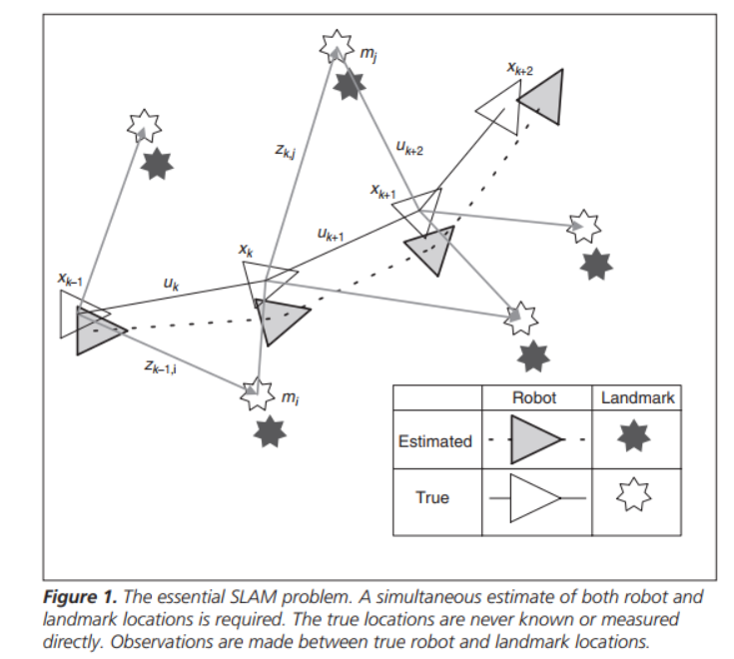
SLAM Problem

Slide 7
Formulation of SLAM problem
In addition, the following sets are also defined:
◆ X0:k = {x0,x1,··· ,xk} = {X0:k-1,xk}: the history of vehicle locations
◆ U0:k = {u1,u2,··· ,uk} = {U0:k-1,uk}: the history of control inputs
◆ m = {m1,m2,··· ,mn} the set of all landmarks
◆ Z0:k = {z1,z2,··· ,zk} = {Z0:k-1,zk}: the set of all landmark observations

Slide 8
Probabilistic SLAM
The probability distribution function is defined as P(xk,m|Z0:k,U0:k,x0) for all times k.
This probability distribution describes the joint posterior density of the landmark locations and vehicle locations
This is computed using Bayes theorem
In probability theory and statistics, Bayes' theorem describes the probability of an event, based on prior knowledge of conditions related to the event.
A state transition model and an observation model are defined describing the effect of the control input (Uk) and observation (Zik) respectively

Slide 9
Probabilistic SLAM
The observation model describes the probability of making an observation zk when the vehicle location (Xk) and landmark locations (m) are known
P(zk|xk,m)
The state transition or motion model or location model for the vehicle can be described in terms of a probability distribution on state transitions such as previous location of robot (Xk-1) and control vector (Uk)
P(xk|xk-1,uk)

Slide 10
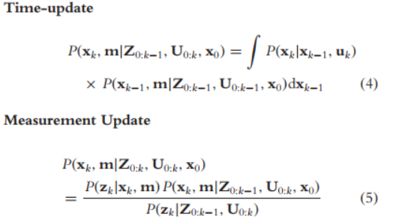
Probabilistic SLAM
The SLAM algorithm is now implemented in a standard two-step recursive - prediction (time update) and correction (measurement-update) form:
These equations provide a recursive procedure for calculating the joint probability
The recursion is a function of a vehicle model and observation model

Slide 11
Solutions to SLAM problem
The most common solution is a vehicle motion model it is modeled by a Gaussian probability distribution. This leads to the use of the extended Kalman filter (EKF) to solve the SLAM problem
The other solution is a vehicle motion model that defines a non-Gaussian probability distribution. This leads to the use of the Rao-Blackwellized particle filter, or FastSLAM algorithm

Slide 12
EKF SLAM
The basis for the EKF-SLAM describes the 2 models as below
- The vehicle motion model
P(xk|xk-1,uk) ⇐⇒ xk = f(xk-1,uk) + wk
where
f(·) is vehicle kinematics
wk is additive Gaussian motion disturbances with covariance Qk
- The observation model
P(zk|xk,m) ⇐⇒ zk = h(xk,m) + vk
h(·) is the geometry of the observation
vk is additive Gaussian observation errors with covariance Rk.

Slide 13
EKF SLAM (contd.)
The standard EKF method can be applied to compute the mean and covariance of the joint probability distribution function.
This EKF-SLAM solution is very well known and popular.
But, some of the key issues are as below
High computational effort - More landmarks means more computation.
Non-linearity - EKF uses linearized models for non-linear motion and observation models. Hence, this leads to inconsistencies.

Slide 14
Rao-Blackwellized Filter
FastSLAM, is based on recursive Monte Carlo sampling or particle filtering.
The high dimensional state-space of the SLAM problem makes direct application of particle filters not feasible.
However, it is possible to reduce the sample space by applying Rao-Blackwellization (R-B) filter
A joint probability state is partitioned as below
P(x1,x2) = P(x2|x1)P(x1)
If P(x2|x1) can be represented analytically then only P(x1) needs to be sampled
Note: Particle filtering
It is a statistical technique used for recursive bayesian filtering and state estimation in dynamic systems. Example scenario: Robot motion and location mapping.
A particle filter represents the state of the system using a set of particles
Each particle is like a hypothesis about the true state of the system at a specific point in time

Slide 15

Rao-Blackwellized Filter (contd.)
The joint probability state may be factored into a vehicle component and a map component:
P(X0:k,m|Z0:k,U0:k,x0) = P(X0:k|Z0:k,U0:k,x0)P(m|X0:k,Z0:k)
Here the probability distribution is on the trajectory X0:k rather than the single location xk
Because, when conditioned on the trajectory, the map landmarks become independent.
This is a key property of FastSLAM and hence it is faster.
Thus, the joint distribution, at time k, is represented by the set where the vehicle component is composed of independent Gaussian distributions (w(k))
Fast SLAM is more capable of generating an accurate map in real outdoor environments.

Slide 16
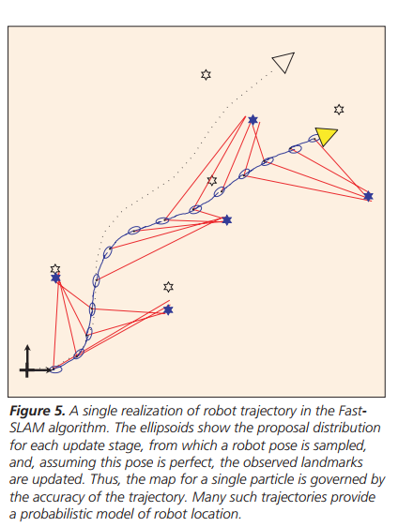
Fast SLAM - Robot trajectory

Slide 17
Implementations of SLAM
Practical applications of probabilistic SLAM have increased in recent years, covering larger areas in more challenging environments.
The “explore and return’’ experiment by Newman was a moderate-scale indoor implementation that validated the EKF-SLAM by returning to a precisely marked starting point. The experiment is remarkable because its return trip was fully autonomous.
Guivant and Nebot pioneered the application of SLAM in very large outdoor environments. They addressed computational issues of real-time operation and also dealing with high-speed vehicle motion, non-flat terrain, and dynamic clutter. Their results are particularly interesting because they are accompanied by accurate GPS results.

Slide 18
Conclusion
This article has described the SLAM problem and the essential solutions for the SLAM problem.
While there are still many practical issues to overcome, especially in more complex outdoor environments, the general SLAM method is now a well understood and established part of robotics.
Part II of this tutorial will summarize more recent work in addressing some of the remaining issues in SLAM

